Slide 1
Digital Cookbook Concept

Slide 2
Main Idea
Create, Read, Update, Delete recipes from a database
Allow users to favorite recipes
Search by Name and Favorite Recipes
Use TTS to read off recipes and voice commands to shift the step

Slide 3
Who’s This Even For?
Chefs / Cooks
Hobbyists
People with tons of deteriorating recipe flash cards and need another way of storing

Slide 4
What’s the purpose?
Ease of access when cooking
Better storage of recipes
Easier to update your recipes
Straight to the point. No need for accounts.

Slide 5
Apps Similar to This Concept
based.cooking - an open source cookbook where you don’t need an account to add recipes but to add recipes you need to go through github
CookBook (IOS app) - No need for accounts, even allows favorites to be filtered, but it has tiny text on a phone screen so when you’re across the kitchen it’s kind of hard to read.
Personal Trainer Cooking (DS) - This app on the Nintendo DS has a speech recognition feature that allows the user to say Next, Back, and Repeat for the traversal of the recipes steps. But again with the IOS app the recipe on a tiny DS screen isn’t very recommended and you couldn’t upload your own. Most recipes were just comfort foods from around the globe.

Slide 6
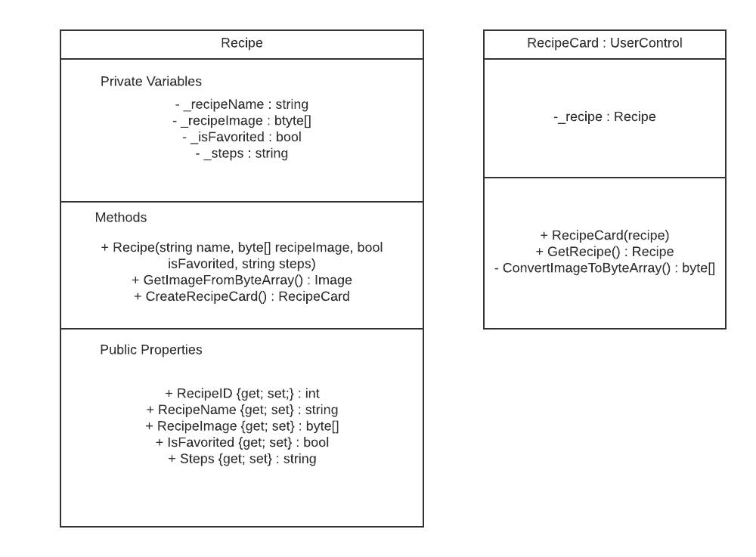
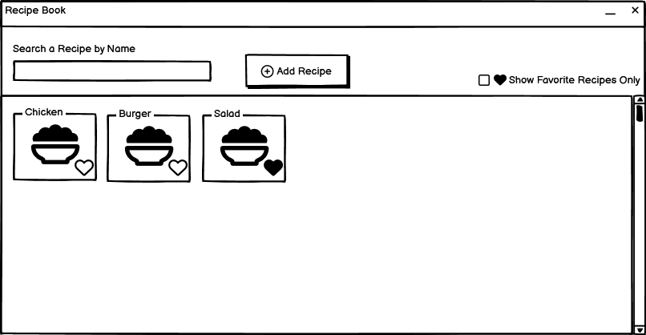
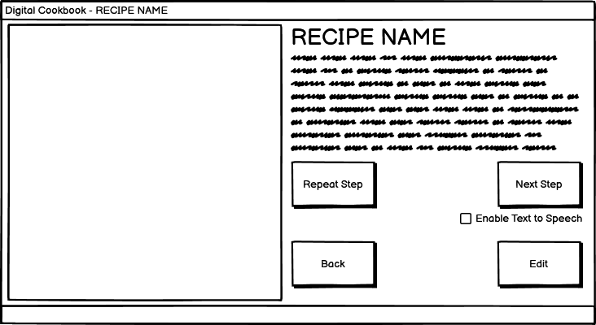
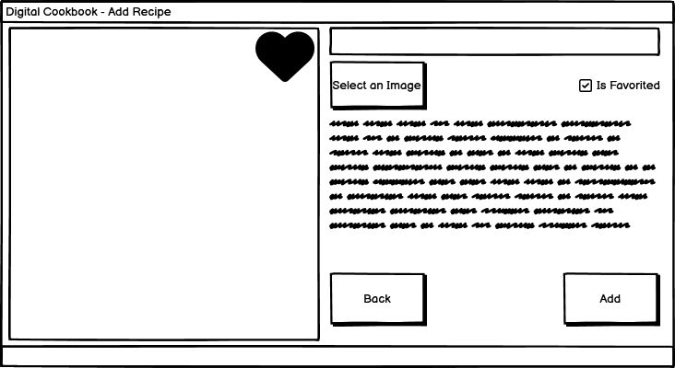
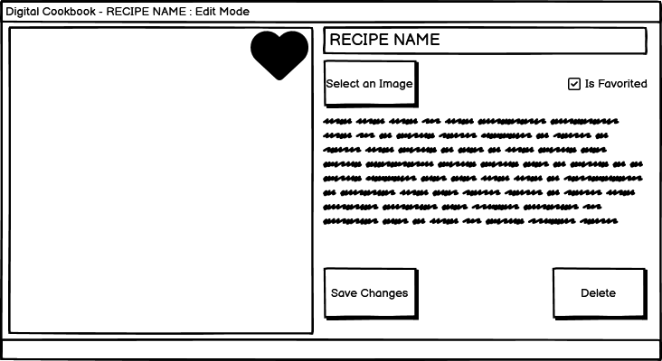
Mockups

